Slide 1

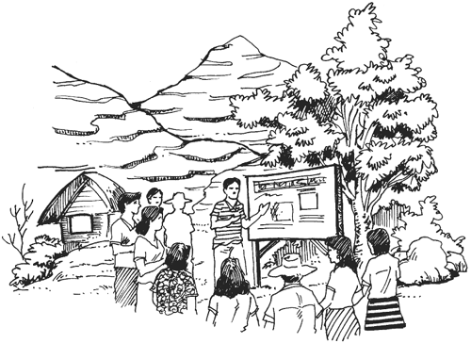
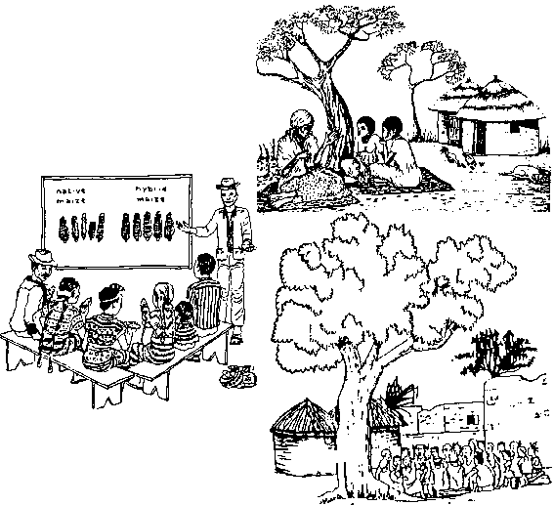

  MODULE 16
Agricultural
Extension
  Services
  and
Notes:
GET ATTENTION by asking, “If an agricultural extension worker ran for office, say, as a Mayor or Vice Mayor of your town (disregarding the financial requirements of launching a candidacy), what do you think are the chances that s/he will win?”
DRAW OUT the participants’ thoughts on why agricultural extension workers may or may not win the hearts and votes of the greater populace, majority of whom are in farming sector.
LINK by asserting that agricultural extension can provide much help for farmers to succeed in farming as a business.

Slide 2

Learning Objectives:
Discuss ways by which agricultural extension practice may be improved to better help farmers succeed in their farming business
Name selected extension programs and services offered by ATI and other DA bureaus and attached agencies
Discuss the scope and activities of agricultural extension
Explain the role of agricultural extension in agriculture and rural development

Slide 3

Outcomes:
At the end of the module, participants are expected to be able to:
Discuss the scope and activities of agricultural extension;
Explain the role of agricultural extension in agriculture and rural development; and
Name selected extension programs and services offered by the Agricultural Training Institute and other DA bureaus and attached agencies.
Discuss ways by which agricultural extension practice may be improved to better help farmers succeed in their farming business.

Slide 4
Structure:
Lesson 1: Scope and Activities of Agricultural Extension
Lesson 2: Role of Agricultural in Agricultural and Rural Development
Lesson 3: Agricultural Training Institute Rice Extension Programs and Services
Lesson 4: Other DA Bureaus and Attached Agencies’ Services and Contact Information
Lesson 5: Ways Forward for a More Responsive Agricultural Extension System

Slide 5
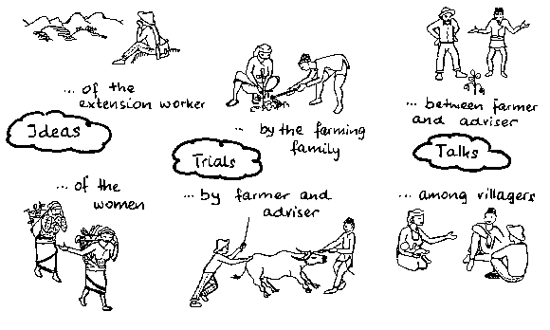
Lesson 1:
Scope and Activities of Agricultural Extension
Learning Outcomes:
At the end of the lesson, participants are expected to be able to discuss the scope and activities of agricultural extension.
Notes:
GET ATTENTION: Break the ice by facilitating a group formation energizer. Invite participants to participate in an activity called Animal Flocking Game.

Slide 6
Activity 1.
Animal flocking game
Notes:
Goal: Participants will form into groups in a fun way.
Duration: 5 minutes
Number of Participants: No. of groups to be formed depends on the number of participants, with four to six members per group.
Materials/ Methodology: Beforehand, prepare small sheet of paper on which will be written farm animals that make sounds, e.g., chicken, pig, cow, duck, carabao, horse, etc. Write each kind of animal on five small piece of folded or rolled paper as lots to be drawn. Shake them in a small box, bowl, can or basket.
Process:
1. Each member will draw a piece of paper from the container.
2. Instruct everyone that no one is to open the piece of paper until everyone has drawn, and they must wait for the facilitator to signal them to open and read what’s written in the sheet.
3. As soon as they read the animal they have drawn, participants are not to utter anything except the noise that the animal makes.
4. Participants search for their group mates by making their animal sound and listening for their flock members. They do this until their flock is complete.
5. Participants will name their group as they wish, often using the name of their animal flock.
Debriefing: Tell the participants that this is just a fun way of breaking the ice while forming task-oriented groups. They will henceforth work on the module exercises with their animal group.

Slide 7
Structure:
Definition of agricultural extension
Roles of agricultural extension and extensionists
Activities considered part of agricultural extension

Slide 8
Activity 2.
Draw
Notes:
Activity 2. In their small (animal-flocked) group, ask participants to draw on chart/manila paper their concept of agricultural extension, illustrating roles, relationships with farmers, research agencies, and other entities.
Each group will present (and explain as necessary) their outputs to the plenary group. Give each presenter 1-2 minutes for each presentation.
EXPLAIN. The facilitator will recap the group outputs with a lecturette using the appropriate PowerPoint slides.

Slide 9
Agricultural Extension
Notes:
Agricultural Extension is defined as informal educational process that aims to raise awareness, advance understanding, and transform farmers’ attitudes towards farming practices that boost up productivity and promote management of the soil and natural resources.

Slide 10
Extension Services
Notes:
In the Agriculture and Fisheries Modernization Act (AFMA) document of 1997, Extension Services refers to the provision of training, information and support services by the government and non-government organizations to the agriculture and fisheries sectors to improve the technical business and social capabilities of farmers and fisher folks.

Slide 11

Lesson 2:
Role of Agricultural Extension in Agricultural and Rural Development
Learning Outcomes:
At the end of the lesson, participants are expected to be able to:
  Identify the roles of an extension worker; and
  Explain the role of agricultural extension in agriculture and rural development
Notes:
GET ATTENTION: Break the ice by facilitating a group formation energizer. Invite participants to participate in an activity called Animal Flocking Game.
LINK: by commenting that one motivating factor in performing one’s job well is in seeing how one’s efforts, no matter how small, contribute to a bigger goal. In agricultural extension, this bigger goal is agricultural and rural development.

Slide 12
Activity 3.
Roles of an Agricultural Extension Worker
Notes:
GOAL: To enable participants to appreciate the multiple roles of an agricultural extension worker.
DURATION: 10 minutes
NUMBER OF PARTICIPANTS: All participants, in their animal-flocked group
MATERIALS/METHODOLOGY: Chart/manila paper, Felt pen, and Meta cards
PROCESS:
Tell the participants that you have two tasks for the different groups. Half of the groups will work on Task 1, while the rest of the groups will work on Task 2.
Task 1 for Selected Groups
Working in their original animal-flocked group, ask the participants to list as many roles they could think that agricultural extension workers play in performing their job. Other roles as persons, e.g., as father, barangay official, church leader, etc. are not to be included – only their agricultural extension roles.
Task 2 for Other /the Rest of the Groups
In their animal-flocked group, tell the participants to generate a list of descriptions or attributes of their concept of agricultural and rural development in their locality.
Both tasks should be under time pressure of five minutes.
Participants will post/display their answers side-by-side around the room or on the board.
DEBRIEFING: With all the groups’ outputs displayed, the facilitator invites two volunteers or asks the participants to volunteer two participants (preferably articulate ones) to provide a synthesis and discuss what the various roles of the agricultural extension worker are, and how these contribute to agricultural and rural development, based on all the group outputs. The second volunteer is asked to augment what the first volunteer may have missed.
Further recap will be provided by the facilitator’s short presentation that follows.

Slide 13

Roles of an Agricultural Extension Worker
Educator, guide in decision-making
Provider of and link to needed/ helpful agricultural information
Link to research
Trainer/ facilitator
Catalyst
Motivator
Advisor
Advocate
Notes:
To RECAP and supplement the participants’ presentations, further EXPLAIN the roles of an agricultural extension worker. Provide examples as necessary.
Educator, guide in decision-making
Provider of and link to needed/helpful agricultural information
Link to research
Trainer/facilitator
Catalyst
Motivator
Advisor
Advocate
EMPHASIZE that an agricultural extension worker needs to be careful in conveying messages and completing messages with appropriate information. Invite sharing of experience from one or two participants on this point.

Slide 14
Lesson 3:
Agricultural Training Institute Rice Extension Programs and Services
Learning Outcomes:
At the end of the lesson, participants are expected to be able to list the services of DA-ATI and its Rice Extension Program, and describe some of these services that they are learning about for the first time.
Notes:
GET ATTENTION: by asking participants what are the extension services offered to them by the Department of Agriculture.
ASK: participants to write their answers on meta cards and post them on the board.
LINK: by asking participants if they have had any previous contact with the DA Agricultural Training Institute (ATI) or have been a recipient of any of its extension services.

Slide 15
Structure:
Department of Agriculture – Agricultural Training Institute (DA-ATI)services
The Rice Extension programs of DA-ATI

Slide 16
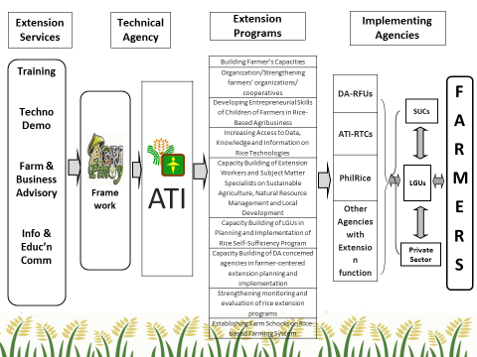
Extension Service Framework of ATI
Notes:
EXPLAIN role of the DA-ATI as the training and extension arm of the Department of Agriculture
EXPLAIN the extension service framework of DA-ATI

Slide 17
Rice Extension Services of ATI
Training Services
    Capacity Building Trainings and Workshops
    Reinforcement Courses (management Trainings, AFE Data Management, AFE M&E System Development, Upland Rice Based Farming System, etc.)
    School on the Air (SOA)

Slide 18
Rice Extension Services of ATI
Training Services
    Technical Briefing / Teknokliniks
    Local farmer technicians
    Farm Business School
    Climate Filed School
    Season long TOT for rice
    E-extension (e-farming, e-leaning, e-trading)

Slide 19
Rice Extension Services of ATI
Techno Demonstrations
    School for Practical agriculture (SPA)
    Farm Schools/Learning Sites
    Upland Palayamanan model farms
    Climate Field School model farms

Slide 20
Rice Extension Services of ATI
Farm and Business Advisory
    Techno Gabay Program (TGP) Farmers' Information Technology Service (FITS)
    Farmers Contact Center
Information and Education Communication

Slide 21

Farmers’ Contact Center
Notes:
DEMONSTRATE the use of the Farmer’s Contact Center:
Web-based (info@e-extension.gov.ph)
Mobile (0920-9462474) (1-800-10-982)
Android (Nutrient Manager for Rice application)
NOTE: Facilitator should be ready with an image (screen grab) of the sites in PowerPoint just in case there is a problem with internet connection.

Slide 22








Lesson 4:
Services and Contact Information of other Bureaus and Attached Agencies of the Department of Agriculture
Notes:
GET ATTENTION by presenting the extension services (other than those related to rice production) offered by ATI.
ASK participants to give other services that they had encountered from other agencies.
STIMULATE INTEREST by asking participants if they had applied these services in their own farms.
PRESENT other services offered by bureaus and attached agencies of the Department of Agriculture (DA).

Slide 23

ICT Based Resources and Tools on Rice/Agriculture
Philippine Rice Research Institute
PhilRice Tel: (044) 456-0285 local 511
Pinoy Rice Knowledge Bank
http://www.pinoyrice.com or http://www.pinoyrkb.com
Notes:
ICT BASED RESOURCES and TOOLS on RICE/AGRICULTURE
NOTE: Have a screen grab of the different sites ready in case these are internet connection problems.
The Philippine Rice Research Institute (PhilRice) under the DA and the International Rice Research Institute (IRRI, an international research agency under the CGIAR group) offer a wide range of rice extension and related services.
Philippine Rice Research Institute (www.philrice.gov.ph)
PhilRice Tel: (044) 456-0285 local 511
Pinoy Rice Knowledge Bank http://www.pinoyrice.com or www.pinoyrkb.com
The Pinoy RKB is a one-stop shop for free and latest information on rice production in the Philippines. It explains the PalayCheck system (in major Philippine dialects) and Palayamanan to help improve rice production and income; contains ready-to-print, illustrated handouts as well as broadcast releases on various rice related topics; learning modules in PowerPoint; audio plugs and interviews with rice experts; educational and entertaining videos; and many more. It also has an offline version that can be downloaded from the website.

Slide 24

ICT Based Resources and Tools on Rice/Agriculture
Philippine Rice Research Institute
PhilRice Tel: (044) 456-0285 local 511
MOET Appv2.0
(Downloadable from PhilRice website)
PhilRice Library
PhilRice Text Center
Send Text/ SMS to +63 920 911 1398
Farming emergency? Questions about rice? Call or text and you shall receive an answer! This is PhilRice’s every day SMS-based help desk and customer support service.
With its info-on-demand feature, you will receive requested information simply by texting the right keyword. For Example, text name of variety (e.g., Rc18) to receive varietal characteristics; name of pest or disease (e.g., STEMBORER) to know its management options; or SEEDS and name of PhilRice Station (e.g., SEEDS NUEVA ECIJA) to know the seeds available in each station in the said province.
Notes:
MOET Appv2.0 (Downloadable from the PhilRice website)
Need help with fertilizer computation? Try MOET Application, it can compute the field fertilizer requirements of an irrigated lowland rice and predict the rice yield if the fertilizer plan is followed.
PhilRice Text Center (Send Text/SMS to +63 920 911 1398)
[Suggestion from reviewer: A transcript of the SMS inquiries and PhilRice’s responses (3-5 examples) can be shown in the PowerPoint – it would be interesting for farmers to see such samples.]
Farming emergency? Questions about rice? Call or text and you shall receive an answer! This is PhilRice’s every day SMS-based help desk and customer support service.
With its info-on-demand feature, you will receive requested information simply by texting the right keyword. For Example, text name of variety (e.g., Rc18) to receive varietal characteristics; name of pest or disease (e.g., STEMBORER) to know its management options; or SEEDS and name of PhilRice Station (e.g., SEEDS NUEVA ECIJA) to know the seeds available in each station in the said province.
PhilRice Library [please provide contact details and what the library has to offer to farmers.]

Slide 25
ICT Based Resources and Tools on Rice/Agriculture
International Rice Research Institute
IRRI Tel: (63-2) 580-5600
1. Rice Knowledge Bank
Notes:
Rice Knowledge Bank
Learn about rice production techniques, agricultural technologies, and best farming practices based on IRRI’s pool of knowledge from research findings, learning and media resources, and in-country projects.

Slide 26

ICT Based Resources and Tools on Rice/Agriculture
International Rice Research Institute
IRRI Tel: (63-2) 580-5600
Rice Crop Manager
http://webapps.irri.org/ph/rcm
(using an HTML5 compatible
web browser on smartphones,
tabs and computers)
Notes:
Rice Crop Manager http://webapps.irri.org/ph/rcm
(using an HTML5 compatible web browser on smartphones, tabs and computers)
Designed for use by extension workers, crop advisers, input providers, and service providers, here’s a customizable crop and nutrient management guide! With RCM, farmers can be provided with actionable recommendation that matches their location- specific cropping practices and needs.

Slide 27

ICT Based Resources and Tools on Rice/Agriculture
International Rice Research Institute
IRRI Tel: (63-2) 580-5600
Rice Doctor
http://ricedoctor.irri.org
Notes:
Rice Doctor http://ricedoctor.irri.org
When your rice is sick, go to Rice Doctor very quick! The diagnostics tool will help to systemically identify problems in your rice crop and provide advice on how to manage them.

Slide 28
ICT Based Resources and Tools on Rice/Agriculture
International Rice Research Institute
IRRI Tel: (63-2) 580-5600
Weed identification Tool
http://www.knowlegebank.irri./org/decision-tools/weed-identification
If the weeds is your problem, Weed Smart is for you! This weed identification tool helps identify the major weeds of rice and also gives additional information, such as on management and geographical distribution of weeds.
IRRI Library/ Trainings / Scholarships
Notes:
Weed identification Tool
http://www.knowlegebank.irri./org/decision-tools/weed-identification
If weeds are your problem, Weed Smart is for you! This weed identification tool helps identify the major weeds of rice and also gives additional information, such as on management and geographical distribution of weeds.

Slide 29


BUREAUS and ATTACHED AGENCIES
Name of Agency | Office Address | Contact Information
Department of Agriculture | Elliptical Road, Diliman, Quezon City | (02) 920 – 3986 / 43 to 69 or 020-2223
Agribusiness and Marketing Assistance Services (AMAS) | Elliptical Road, Diliman, Quezon City | 920-4077
Bureau of Agriculture and Fisheries Standard BAFS) | BPI Compound, Visayas Ave., Diliman Quezon City | 920-6131/34 455-0031
Bureau of Agricultural Research (BAR) | RDMIC Building, Visayas Ave. cor. Elliptical Road, Diliman Quezon City | +63 2 928-8624 / +63 2 928-8505
Bureau of Agricultural Statistics (BAS) | 2nd Flr. Ben-Lor Bldg., 1184 Quezon Avenue, Quezon City | Tel.no: (632)371-20-50, (632)371-20-92
Bureau of Plant Industry (BPI) | 692 San Andres Street, Malate, Manila | (02) 525-7857 or 525-7909
Bureau of Soils and Water Managemnet (BSWM) | Visayas Avenue, Diliman, Quezon City | (632) 920-4382 (632) 923-0433

Slide 30
BUREAUS and ATTACHED AGENCIES
Name of Agency | Office Address | Contact Information
Fertilizer and Pesticide Authority (FPA) | FPA Bldg., BAI Compound, Visayas Ave., Diliman, Quezon City | 920-8173 920-0068 9208573 384-3957
Philippine Center for Postharvest Development and Mechanization (PHILMECH) | Central Luzon State University (CLSU) Compound, Science City of Munoz, Nueva Ecija | (+6344) 4560-213 (+6344) 4565-770 (+6344) 4560-287 (+6344) 4560-290
National Food Authority (NFA) | Public Affairs Department 3rd Floor SRA Building North Avenue, Diliman Quezon City | 09064363133
National Irrigation Administration (NIA) | NIA Complex, EDSA, DilimaN, Quezon City | (632) 929-6071 to 79; 926-8090 to 91
Philippine Crop Insurance Corporation (PCIC) | 7/F Building A, NIA Complex, EDSA, Diliman, Quezon City | (02) 441-1322 to

Slide 31
Thank you!!!

